Slide 1
The Levels of Obesity in South America
Gabrielle Salamanca

Slide 2
1.
The Dataset
Obesity Levels

Slide 3
The Dataset
About
Provided by the DSS Club
kaggle.com
From:
Mexico
Peru
Colombia
2111 rows
17 columns
No missing values
Contains
Personal information
Age
Gender
Height
Weight
Habits
Eating
Exercise
Smoking

Slide 4
The Dataset: Response Variable
Variable: Nobeyesdad
Obesity lvl
Weight category
In kilograms
Category:
Insufficient Weight
Normal Weight
Overweight Lvl I
Overweight Lvl II
Obesity Type I
Obesity Type II
Obesity Type III

Slide 5
The Dataset: Response Category
Insufficient Weight
39-65 kg
85.98-143.3 lbs
Normal Weight
42.3-87 kg
93.26-191.8 lbs
Overweight Lvl I
53-91 kg
116.85- 200.62 lbs
Overweight Lvl II
60-102 kg
132.28-224.87 lbs
Obesity Type I
75-125 kg
165.35-275.58 lbs
Obesity Type II
93-130 kg
205.03-286.6 lbs
Obesity Type III
102-173 kg
224.87- 381.4 lbs

Slide 6
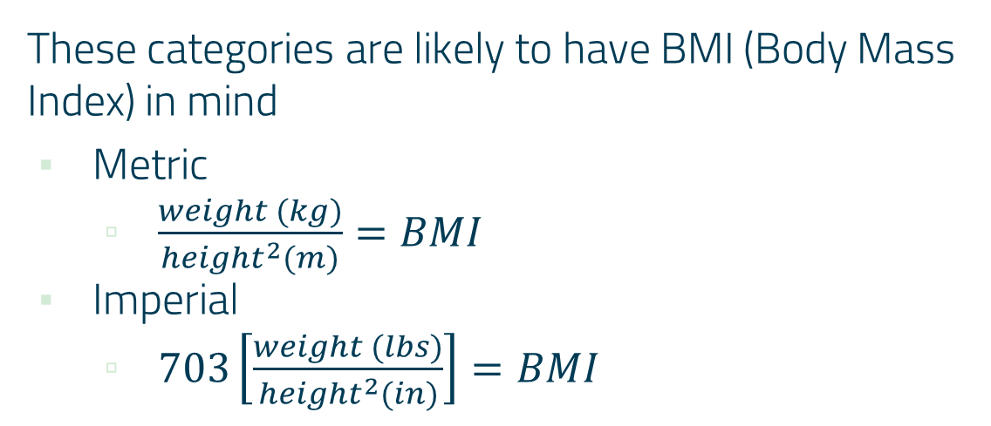
The Dataset: NOTE!
These categories are likely to have BMI (Body Mass Index) in mind
Metric
$\frac{weight (kg)}{{height}^{2}(m)}=BMI$
Imperial
$703\left[\frac{weight (lbs)}{{height}^{2}(in)}\right]=BMI$

Slide 7
The Dataset: Goal
From kaggle.com:
Obesity, which causes physical & mental problems, is a global health problem with serious consequences. The prevalence of obesity is increasing steadily, & therefore, new research is needed that examines the influencing factors of obesity & how to predict the occurence of the condition according to these factors.

Slide 8
Your BMI concerns your height and weight. But are there other factors that affect your weight category?

Slide 9
The Dataset: Goal
Classification
Find a model provides the most accurate prediction
Response variable
Obesity lvl

Slide 10
Data Visualization

Slide 11
ObesityDataSet_raw_and_data_sinthetic
 | Age | Gender | Height | Weight | Alcohol Consumption | …
1 | 21 | Female | 1.62 | 64.0 | No | …
2 | 21 | Female | 1.52 | 56.0 | Sometimes | …
3 | 23 | Male | 1.80 | 77.0 | Frequently | …
4 | 27 | Male | 1.80 | 87.0 | Frequently | …
5 | 22 | Male | 1.78 | 89.9 | Sometimes | …
. . . | . . . | . . . | . . . | . . . | . . . | . . .

Slide 12
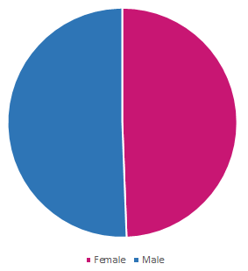
The Gender Pie
2111 participants
1043 females
1068 males

Slide 13
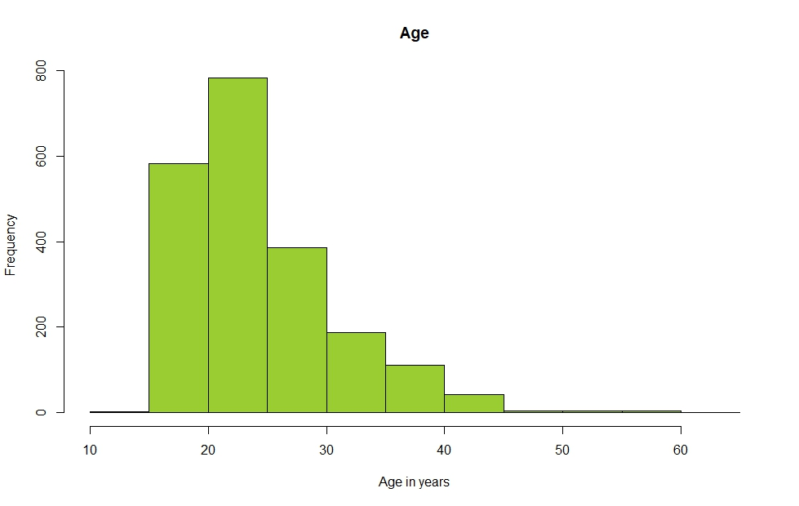
Histogram: Age
Min: 14 yrs old
Max: 61 yrs old

Slide 14
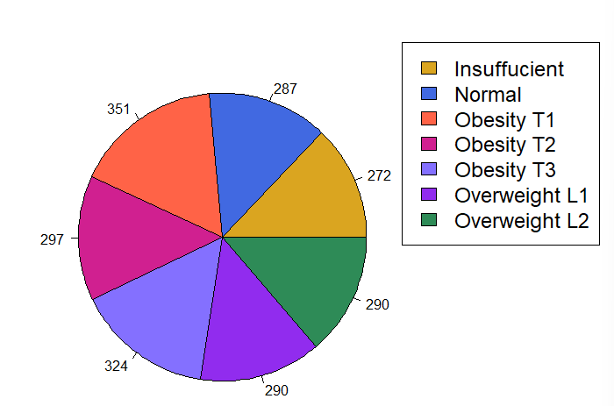
Weight Categories

Slide 15
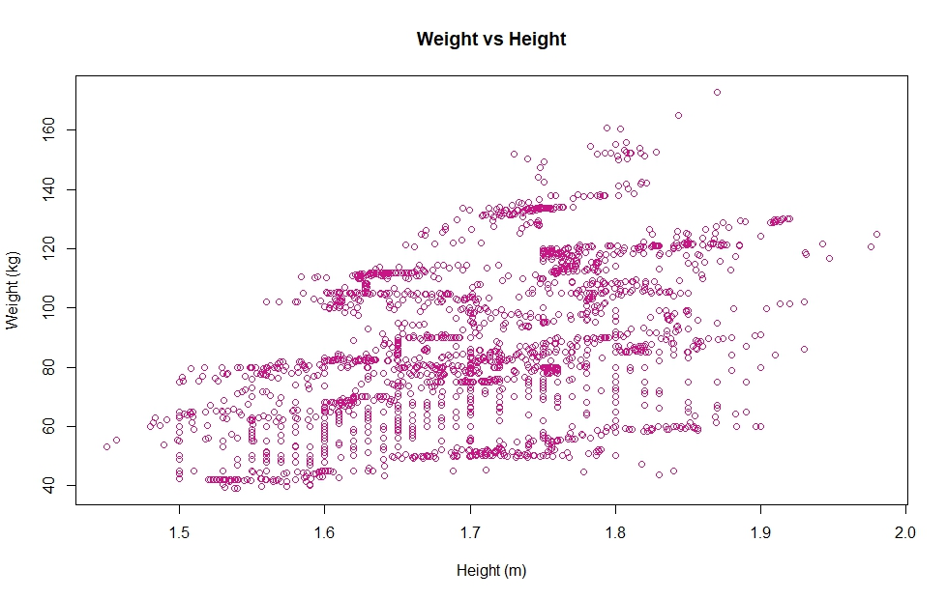
Weight vs Height

Slide 16
2.
Cleanup, Organization, & Such
Additional steps before continuing?

Slide 17
Data Cleanup
None!
No missing values
No notable outliers
Consideration:
Removing category
Insufficient Weight
If looking at obesity lvls
Concern only for the obese/overweight
Normal for baseline

Slide 18
Data Consideration
New dataset
Removed “insufficient weight” category
Separate train & test data
Results:
Error:
All arguments must have the same length
Warning:
longer object length is not multiple of shorter object length

Slide 19
Organization
Original columns
CALC
FAVC
FCVC
TUE
CAEC
Nobeyesdad
Renamed columns
Alcohol Consumption
High Caloric Food Consumption
Vegetable Consumption
Screen Time
Snacking
Obesity lvl

Slide 20
3. Fits & Methods
What has been done?

Slide 21
Model Fits: GLM
Data Splitting
80% training
20% test
Manually go through fits for all 16 vars
Linear → Max
Max variable fits
summary()
Find most significant vars
Use a variation of those to find best fit

Slide 22
Model Fits: GLM
anova()
Didn’t give the significant vars
Warnings
Fitted probabilities numerically 0 or 1 occurred
Algorithm didn’t converge
chisq.test()
Error
‘List’ obj can’t be coerced to type ‘double’

Slide 23
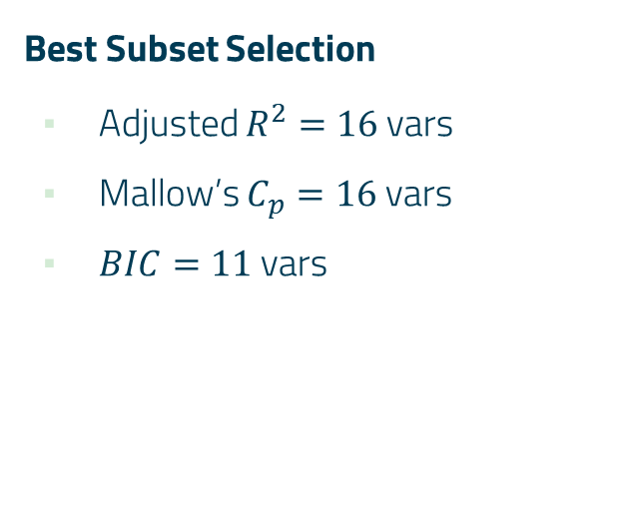
Model Method: Best Subset Selection
Best Subset Selection
Adjusted $R^{2}=16$ vars
Mallow’s $C_{p}=16$ vars
$BIC=11$ vars
Opinion
summary(16 variables)
No significant p-values
0.982 - 1
BIC
More reasonable

Slide 24
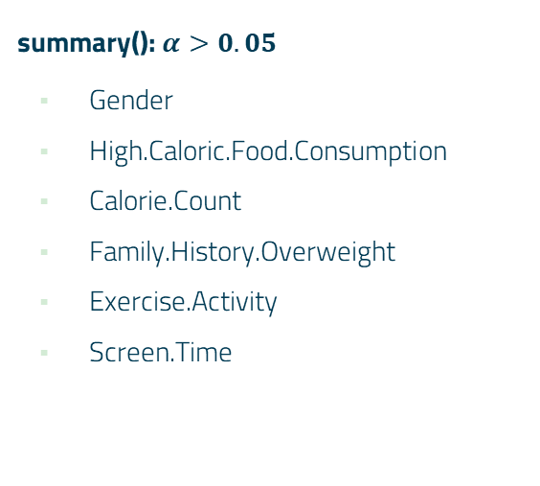
Model Fits: 1st Version
glm(Obesity.Lvl~)
Age, Gender
Weight, High.Caloric.Food.Consumption
Main.Meal.Consumption, Calorie.Count
Water.Consumption
Family.History.Overweight
Exercise.Activity, Screen.Time
Snacking
summary(): $α>0.05$
Gender
High.Caloric.Food.Consumption
Calorie.Count
Family.History.Overweight
Exercise.Activity
Screen.Time

Slide 25
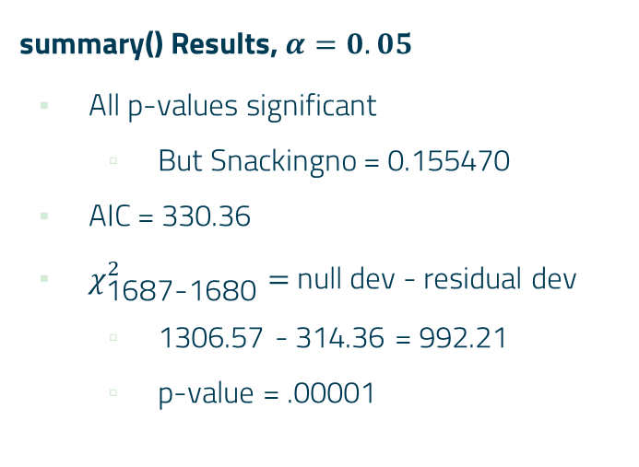
Model Fits: 2nd Version
glm(Obesity.Lvl~)
Age
Weight
Main.Meal.Consumption
Water.Consumption
Snacking
summary() Results, $α=0.05$
All p-values significant
But Snackingno = 0.155470
AIC = 330.36
$χ_{\text{1687-1680}}^{2}=$ null dev - residual dev
1306.57 - 314.36 = 992.21
p-value = .00001

Slide 26
Model Fit & Methods
Chosen fit
glm.fit2 = glm(Obesity.Lvl ~ Age + Weight + Main.Meal.Consumption + Water.Consumption + Snacking)
Methods
QDA
LDA

Slide 27
Method: Linear Discriminant Analysis
Classification
LDA
Supervised learning algorithm specifically designed for classification tasks, aiming to identify linear combo of features that optimally segregates classes w/in dataset
Source:
https://www.geeksforgeeks.org/ml-linear-discriminant-analysis/

Slide 28
Method: Quadratic Discriminant Analysis
Classification
QDA
Similar to LDA
Relaxed assumption
Mean & coV of all classes are equal
Calculation done separately ∀ class
Source:
https://www.geeksforgeeks.org/quadratic-discriminant-analysis/

Slide 29
Model Fit: Prediction
Glm.fit2 = 0%
 | Insufficient | Normal | Ob T1 | Ob T2 | Ob T3 | Ow L1 | Ow L2
No | 44 | 11 | 0 | 0 | 0 | 0 | 0
Yes | 9 | 39 | 71 | 57 | 83 | 58 | 51

Slide 30
Model Fit: Method Testing
QDA
Error
Rank deficiency in group Obesity Type 3
LDA
No errors
59.81087%
😰

Slide 31
Model Fits: 3rd Version
Run new fit I’ve used previously
Use summary() to see best variables
Height
Weight
glm.fit3 = glm(Obesity.Lvl ~ Weight + Height)
Runs w/ no errors when running the other methods

Slide 32
Model Methods: QDA
 | Insufficient | Normal | Ob T1 | Ob T2 | Ob T3 | Ow L1 | Ow L2
Insufficient | 57 | 3 | 0 | 0 | 0 | 0 | 0
Normal | 0 | 45 | 0 | 0 | 0 | 0 | 0
Ob T1 | 0 | 0 | 73 | 0 | 0 | 0 | 1
Ob T2 | 0 | 0 | 0 | 55 | 6 | 0 | 0
Ob T3 | 0 | 0 | 0 | 1 | 63 | 0 | 0
Ow L1 | 0 | 2 | 0 | 0 | 0 | 46 | 6
Ow L2 | 0 | 0 | 2 | 0 | 0 | 2 | 61

Slide 33
Model Methods: LDA
 | Insufficient | Normal | Ob T1 | Ob T2 | Ob T3 | Ow L1 | Ow L2
Insufficient | 48 | 6 | 0 | 0 | 0 | 0 | 0
Normal | 9 | 33 | 0 | 0 | 0 | 0 | 0
Ob T1 | 0 | 0 | 71 | 0 | 0 | 0 | 1
Ob T2 | 0 | 0 | 2 | 56 | 13 | 0 | 0
Ob T3 | 0 | 0 | 0 | 1 | 56 | 0 | 0
Ow L1 | 0 | 11 | 0 | 0 | 0 | 46 | 6
Ow L2 | 0 | 0 | 2 | 0 | 0 | 2 | 61

Slide 34
Model Methods: Results
Prediction
0%
QDA
94.56265%
LDA
87.70686%
😄

Slide 35
4. Improvements
That said…

Slide 36
If I had more time…
Further exploration on best fit
Esp making it consistent
summary(fit) result changes every time I go back to R
Figure out the prediction table with the fit
Apply more methods

Slide 37
CREDITS
Presentation template
SlidesCarnival
Dataset
Data Science Society
kaggle.com

Slide 38
THANKS!
Any questions?
Any suggestions?

